Slide 1
Image Segmentation

Slide 2
In previous chapters, various methods were studied where both input & output are images.
In morphology, input is images while outputs are generally attributes extracted from input images, e.g., boundary, object, etc.
Segmentation is another step in that direction.
Segmentation subdivides the image into its constituent objects or regions.
Most of the segmentation methods are based either on discontinuity(partition image based on abrupt changes in intensity—edge based) or similarity(regions that are similar based on some predefined criteria—region based)

Slide 3
What Is Image Segmentation?
Image segmentation is a method of dividing a digital image into subgroups called image segments
It reducing the complexity of the image and enabling further processing or analysis of each image segment.
segmentation is the assignment of labels to pixels to identify objects, people, or other important elements in the image.

Slide 4
Image segmentation is a key building block of computer vision technologies and algorithms.
It is used for many practical applications
medical image analysis,
computer vision for autonomous vehicles,
face recognition and detection,
video surveillance, and
satellite image analysis.

Slide 5
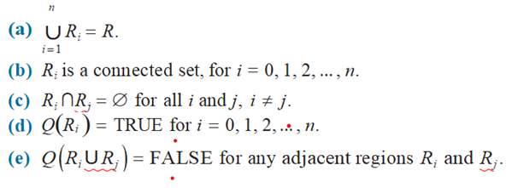
FUNDAMENTALS
Let R =spatial region occupied by an image.
We may view image segmentation as a process that partitions R into n subregions,
R₁, R₂ , …, Rn , such that
2
Segmentation must be complete, i.e., every pixel must be in region.
Points in region are connected
Regions must be disjoint
Same intensity
Two regions are different.

Slide 6
Segmentation algorithms are based on 2 categories dealing with properties of intensity values:
discontinuity
similarity.
Discontinuity
Boundaries of regions are different from each other, and from the background.
We have to allow boundary detection based on local discontinuities in intensity.
Edge-based segmentation is the principal approach used in this category.

Slide 7
Similarity :
Based on partitioning an image into regions that are similar according to a set of predeﬁned criteria.
Region-based segmentation is the principal approach used in this category.

Slide 8
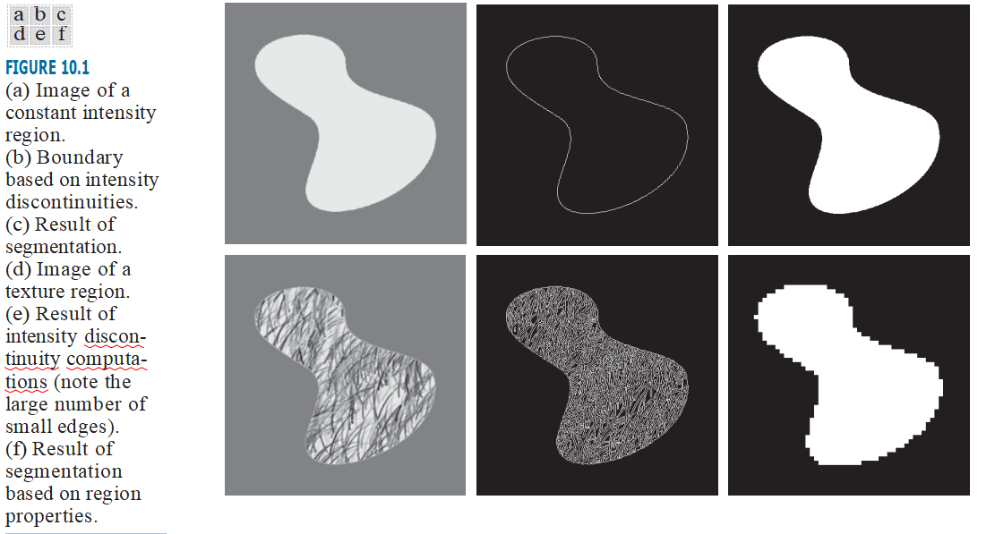

Slide 9
segmentation methods that are based on detecting sharp, local changes in intensity.
3 types of image characteristics in which
Isolated points,
Lines, and
Edges

Slide 10
A line may be viewed as a thin edge segment in which
the intensity of the background on either side of the line is either much higher or much lower than the intensity of the line pixels.
An isolated point may be viewed as a foreground (background) pixel surrounded by background (foreground) pixels.
Edge pixels are pixels at which the intensity of an image changes abruptly, and
Edges are sets of connected edge pixels.
Edge detectors are local image processing tools designed to detect edge pixels

Slide 11
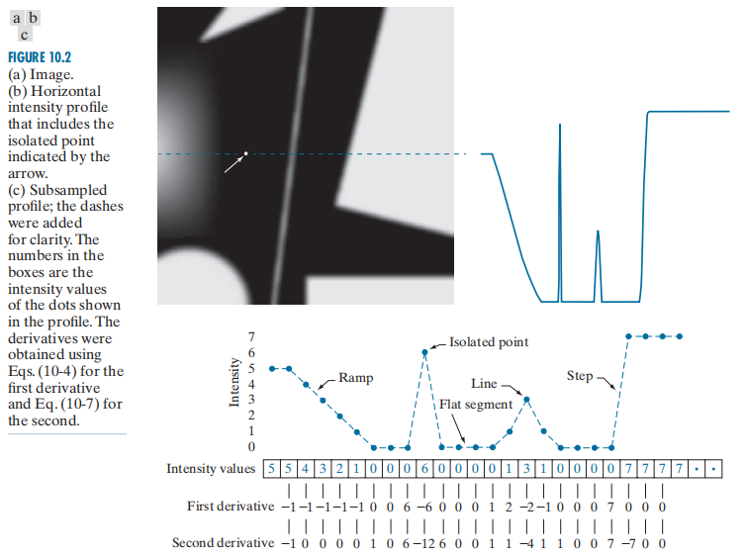

Slide 12
local averaging smoothes an image.
local changes in intensity can be detected using derivatives
first- and second-order derivatives are used.
we require that any approximation used for ﬁrst derivatives
must be zero in areas of constant intensity;
must be nonzero at the onset of an intensity step or ramp; and
must be nonzero at points along an intensity ramp.
Similarly, for second derivatives

Slide 13


First order derivative
Second order derivative

Slide 14
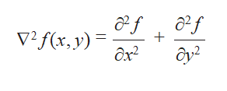
DETECTION OF ISOLATED POINTS
we know that point detection should be based on
the second derivative which, using the Laplacian:
The Laplacian is then
∆²f (x, y) = f (x + 1, y) + f (x - 1, y) + f (x, y + 1) +
f (x, y - 1) - 4 f (x, y)

Slide 15

A point has been detected at a location (x, y) on
which the kernel is centered if the absolute value of the response of the filter at that point exceeds a specified threshold T
Such points are labeled 1 and all others are labeled 0 in the output image, thus producing a binary image. In other words, we use the expression:

Slide 16
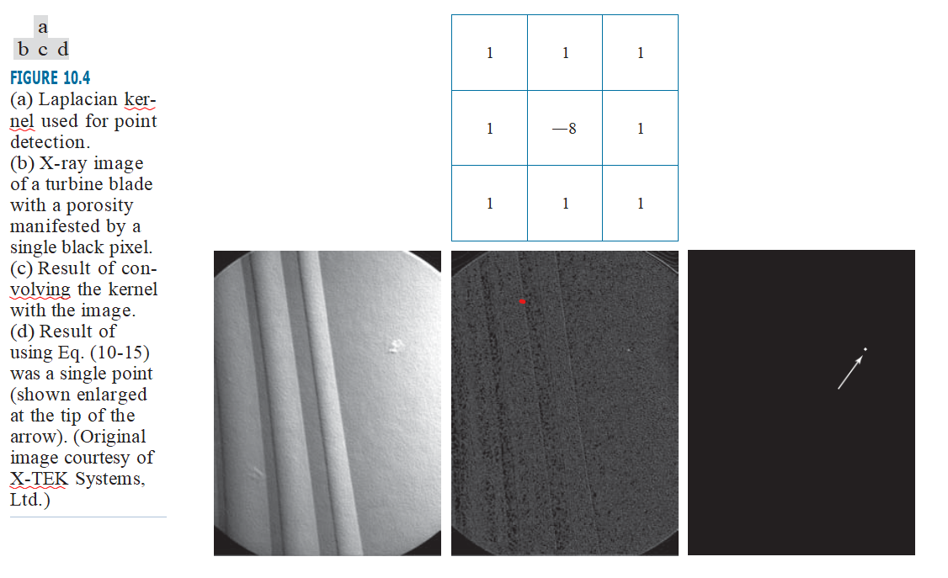

Slide 17
LINE DETECTION
second derivatives to result in a stronger filter response, and to produce thinner lines than first derivatives. Thus, we can use the Laplacian kernel
As the magniﬁed section shows, mid gray represents zero, darker shades of gray represent negative values, and lighter shades are positive. The double-line effect is clearly visible in the magniﬁed region.

Slide 18
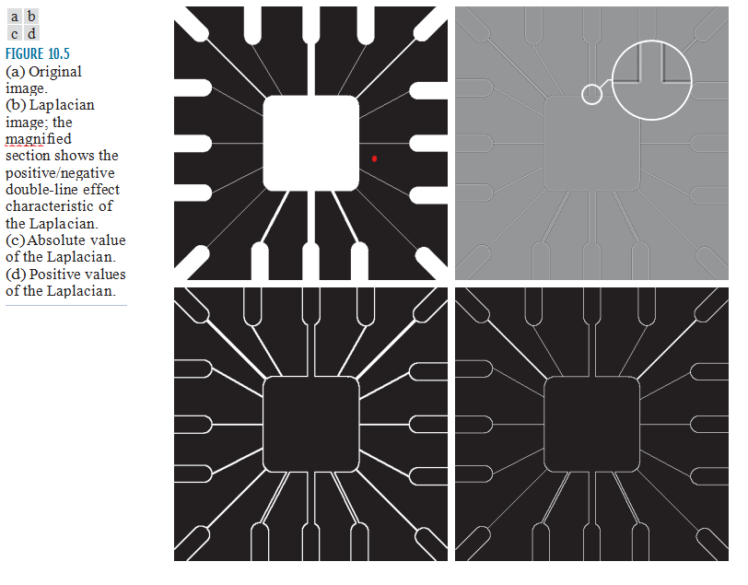

Slide 19
The Laplacian detector kernel is isotropic, so its response is independent of direction (with respect to the four directions of the 3 ×3 kernel: vertical, horizontal, and two diagonals).
Often, interest lies in detecting lines in speciﬁed centered on a line of constant intensity 5 pixels wide, the response will be zero, thus producing the effect just mentioned. When we talk about line detection, the assumption is that lines are thin with respect to the size of the detector.

Slide 20
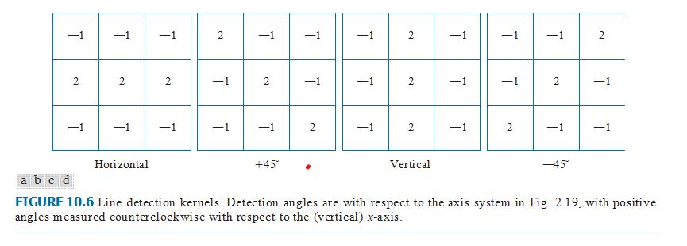
Suppose that an image with a constant background and containing various lines (oriented at 0°, ±45°, and 90°) is ﬁltered with the ﬁrst kernel.
The maximum responses would occur at image locations in which a horizontal line passes through the middle row of the kernel.

Slide 21
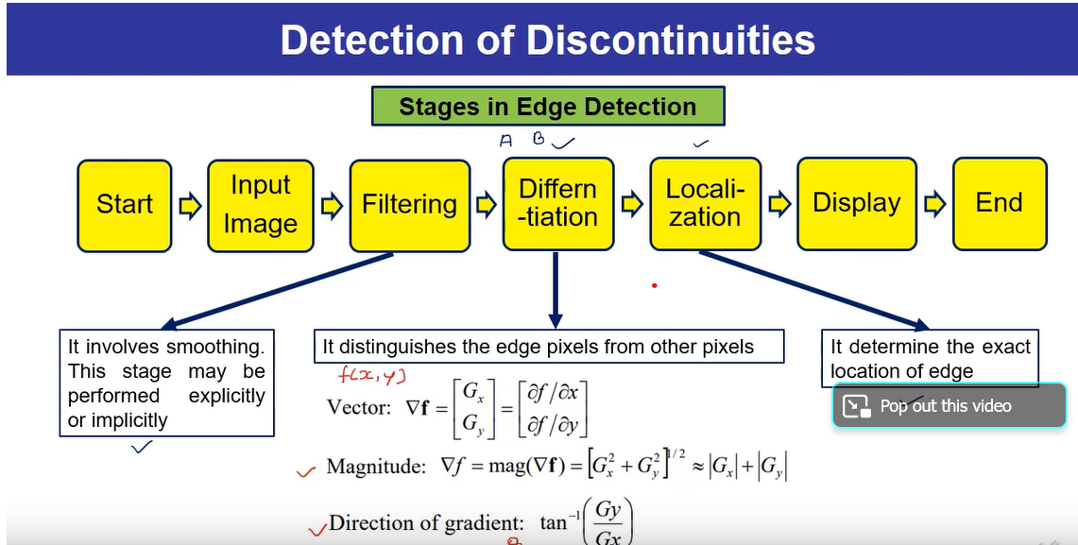

Slide 22
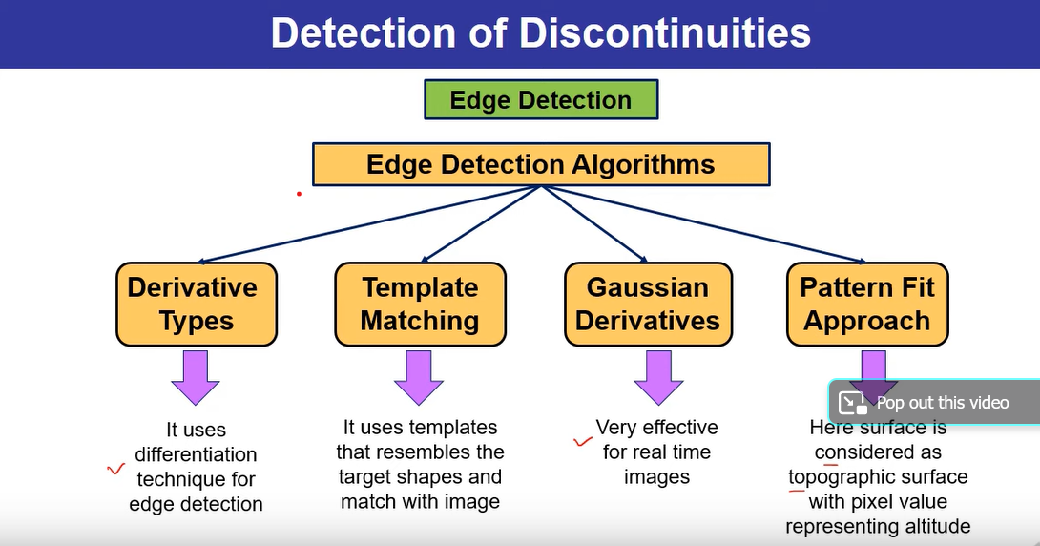

Slide 23
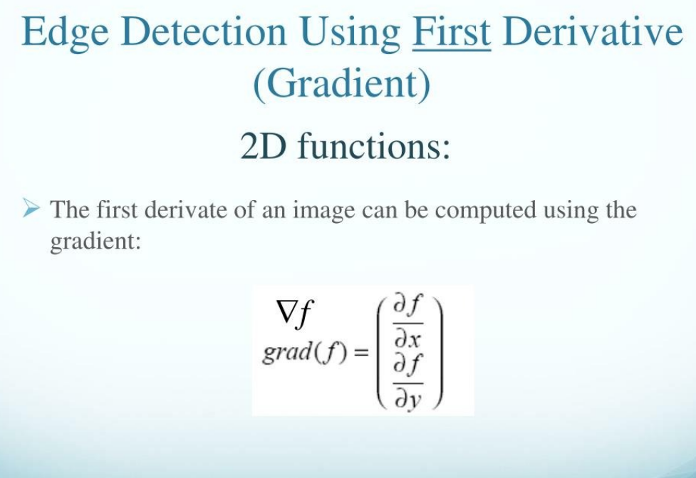

Slide 24
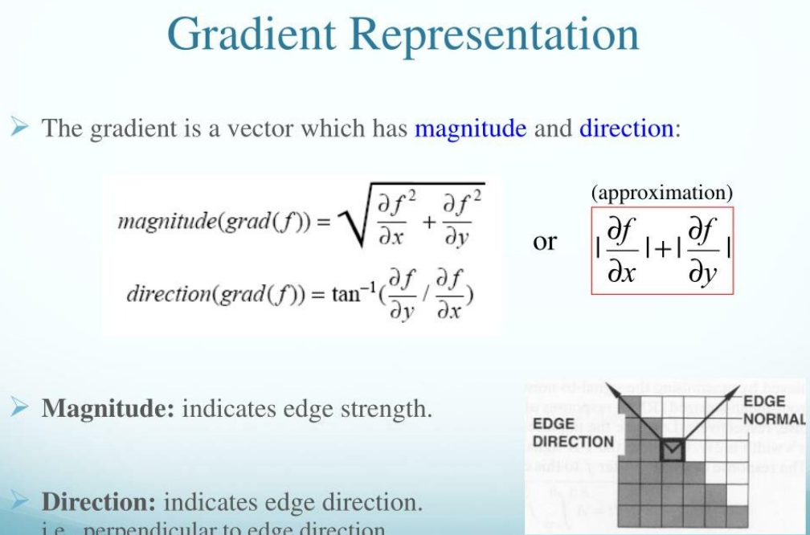

Slide 25
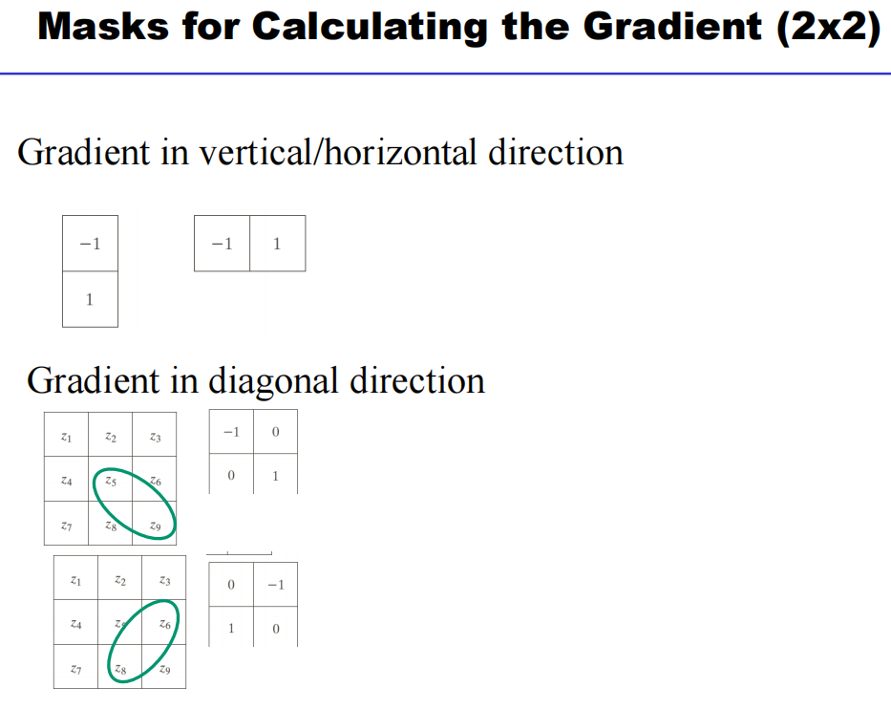

Slide 26
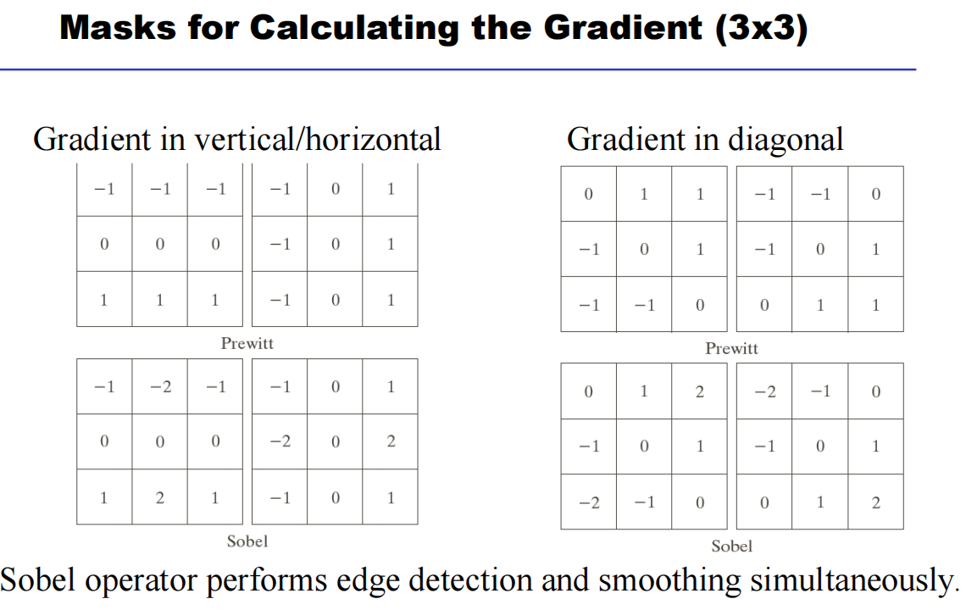

Slide 27


Using prewitt operators
The partial derivatives using mask of size 3×3 are given by
Using Sobel operators

Slide 28
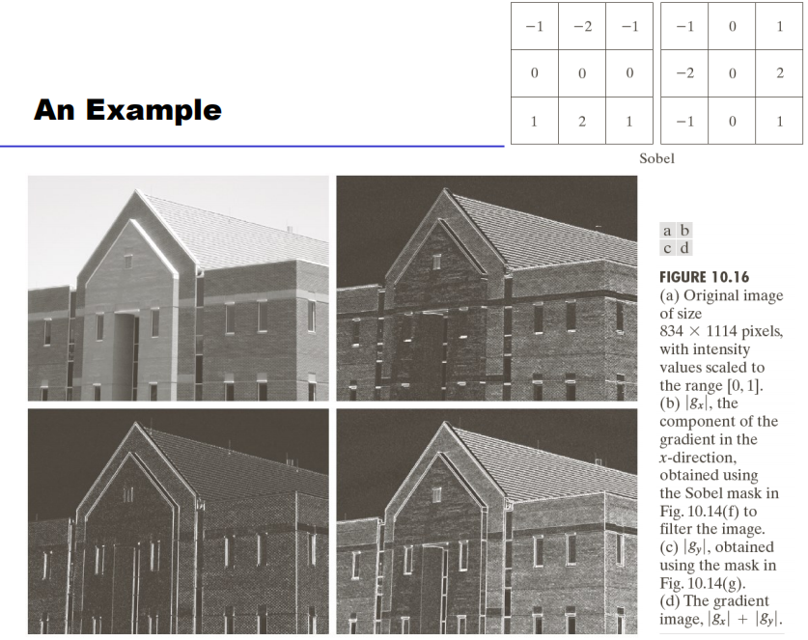

Slide 29
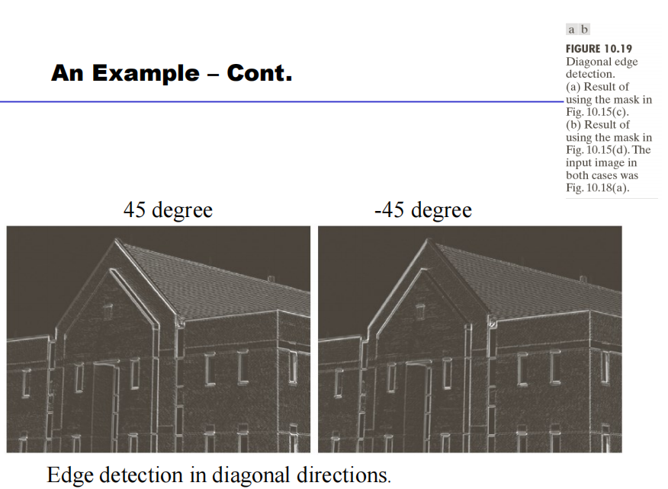

Slide 30
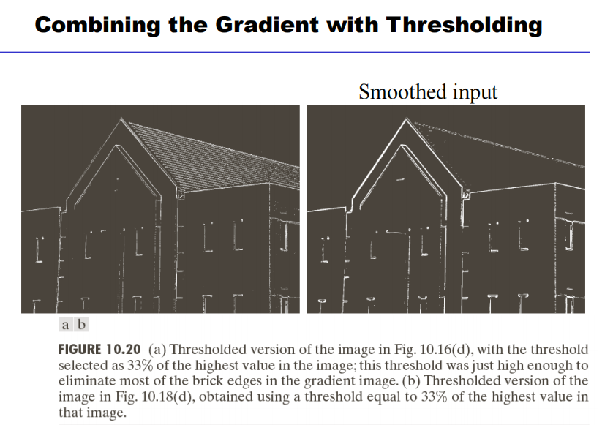

Slide 31
